Slide 1
Senior Project Portal 1.0
Senior Project
Fall 2015
Christopher Jones
Instructor Dr. Masoud Sadjadi
December 11, 2015

Slide 2
Problem Definition
Currently, four web applications are used for Senior Project
Senior Project Website
Virtual Job Fair
Collaborative Platform
Mobile Judge
All four are independent web applications
Independent user authentication systems
No method for accessing them from the same location

Slide 3
Solution
Create a stand-alone site to serve as a portal for Senior Project
Allow users to log in with their FIU Google account credentials (i.e. student@fiu.edu) and authenticate them with Google
After user is logged in to the portal, provide them with a home page with links to all of the Senior Project sites

Slide 4
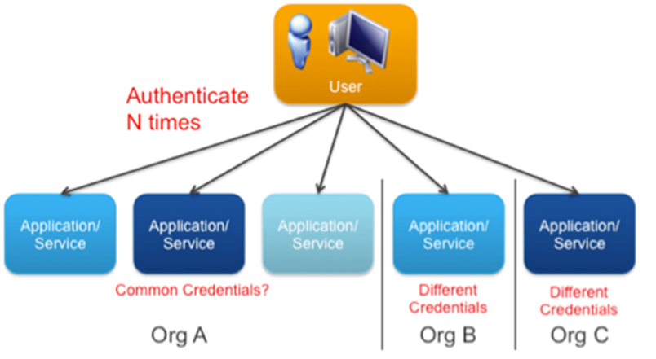

Solution
The implemented system should have single sign-on capability
Property allowing user to log in with a single ID and single password and gains access to several other web applications
Prevents user from entering credentials for each individual application

Slide 5
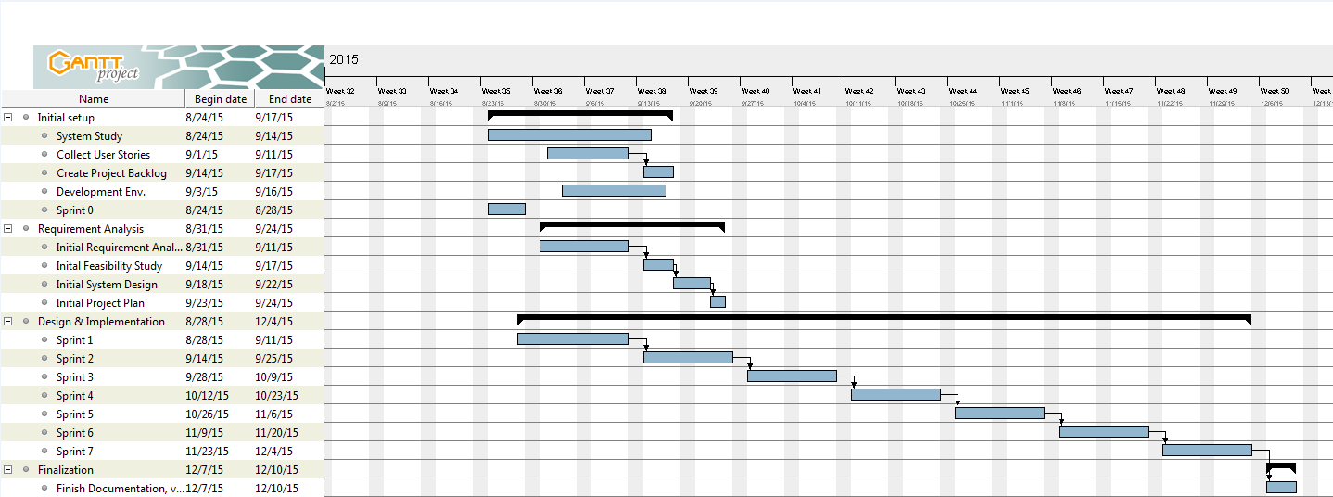
Gantt Chart

Slide 6
Implemented User Stories
Students can access a portal with links to all current Senior Project sites
Students can log in to the portal using their FIU Gmail credentials
Students can be signed in to Senior Project sites automatically
Students can view a dynamic list of links to all current Senior Project sites
Administrators can delete sites from the portal
Administrators can update sites on the portal
Administrators can add sites to the portal
Administrators can search the list of portal sites

Slide 7
Students can be signed in to Senior Project sites automatically
Description:
As a student user, I would like to be automatically logged in to the Virtual Job Fair, Collaborative Platform, Senior Project and Mobile Judge so that I can have easy access to all sites in a centralized location
Acceptance Criteria:
User is able to log in to a portal which grants them links to all Senior Project web applications
Every Senior Project site (listed above) will provide a link back to the portal
When user is logged in and activates a link to a Senior Project site, they are redirected to that site and logged in automatically

Slide 8
Use Cases
Student Log In
Administrator Log In
Log Off
Delete Site
Update Site
Add Site
Sign In To Senior Project Site

Slide 9
Sign In to Senior Project Site
Use Case | Sign In to Senior Project Site
Description | Allows student to select a Senior Project site, get sent to the site and logged in to the site.
Actors | Student
Pre-conditions | Actor must be currently logged into the system.
Steps | 1) The actor activates a link to a Senior Project site on the portal. 2) The system opens a new tab and sends the appropriate login credentials to the Senior Project site in the tab. 3) The credentials are validated on the external site, and the actor is logged in to that system.
Post-conditions | Actor is logged in to the external site.
Alternative Steps | None.

Slide 10
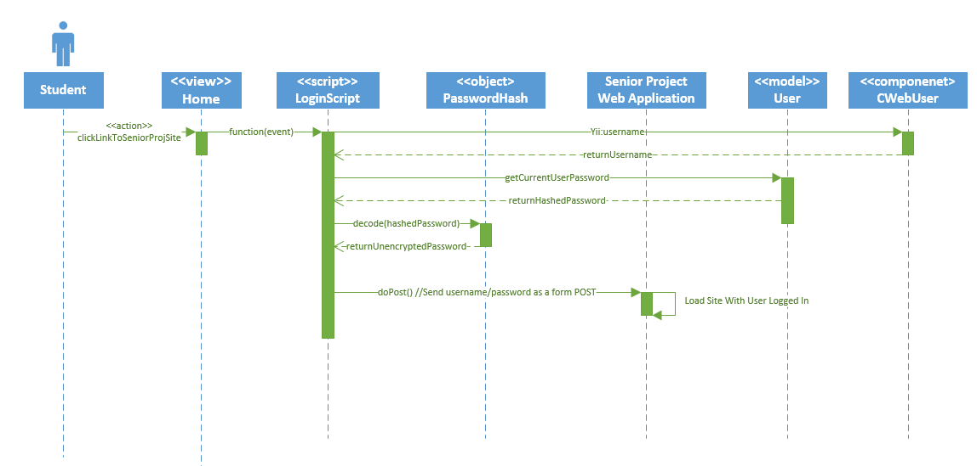
Sign In to Senior Project Site

Slide 11
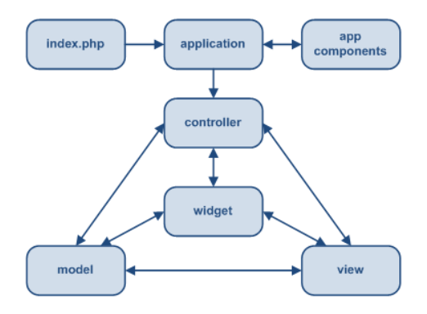
Architecture

Slide 12
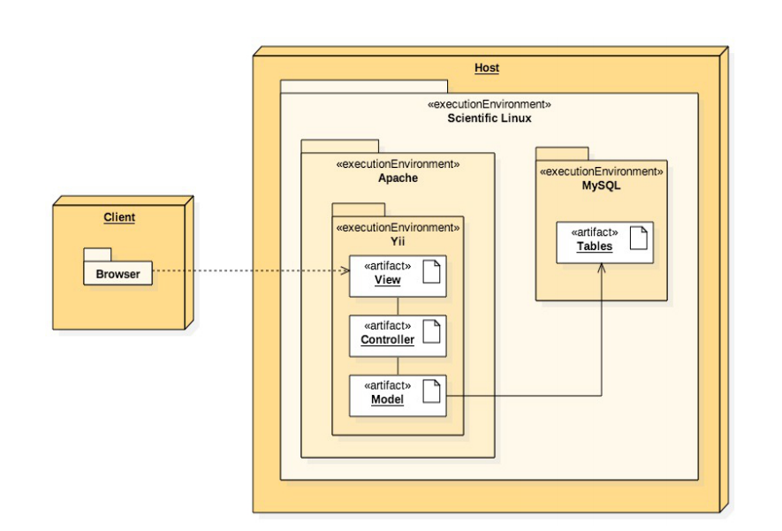
Deployment

Slide 13
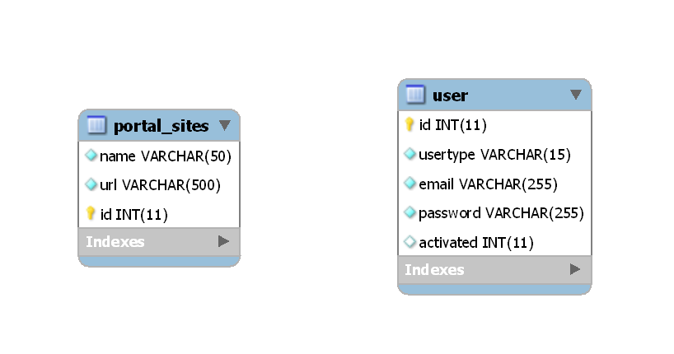
Persistent Data Design

Slide 14
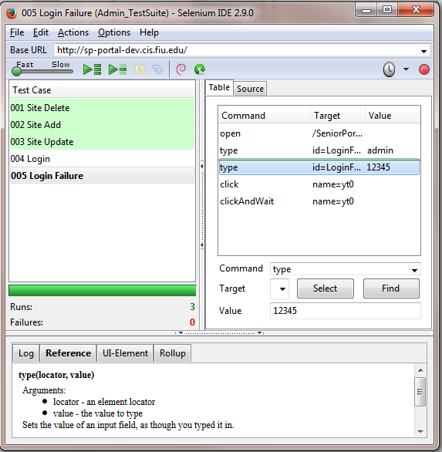
Testing
The system was tested through the use of automatic regression tests on Selenium IDE
Test cases were created for Admin features, with the purpose of identifying defects in the system and addressing them during development

Slide 15
Thank You!
Questions?
Christopher Jones
cjone089@fiu.edu

